Slide 1
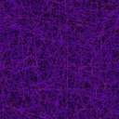
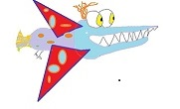
Flappy Birds
Developer: Christian Mcgravey
Project Management and Design: Karl Swanson

Slide 2
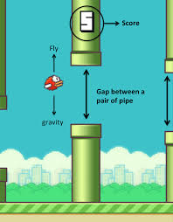
Game Concept Flappy Birds
The player uses the space bar to control their bird.
The Space bar moves the bird up.
The fall function pulls the bird back down.
Watch out for the Walls!
Ohh no! There are two walls always moving toward the Flappy bird.
But don’t worry you can fit!
There is always enough space for the Flappy bird to fit through.
The goal is to make sure your bird does not crash into either wall.

Slide 3
Points
Congratulations you made it through the walls so you get a point.
Each time you gain a point the speed at which the walls track toward your bird will increase.
Your bird will die and the game will restart if you hit a wall, any points scored will reset.
There will be Leader board that tracks the 3 best scores of all time.
You are in control. Will your bird flappy its way to victory on the Leader Board, or floppy into the walls of defeat.
Use the force to sense the walls before they can actually be seen!

Slide 4
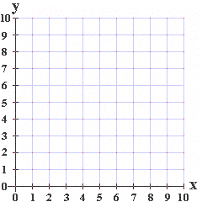
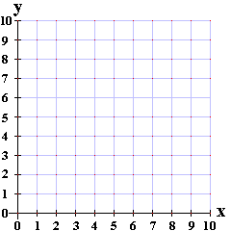
Game Board
Step 1
Step 2
Make Top Wall
Gap between walls must be greater than the bird.
bird
bird
Cartesian Coordinate system
Make a bottom wall

Slide 5
Game Board part 2
Step 3
Step 4
Once the walls reach ¾ of the way towards x = 0 than generate another set of walls
Make the walls move towards x = 0

Slide 6
Game Board part 3
Step 5
Step 6
8
Jump function lifts bird into higher y coordinates.
Create a score board that adds a point every time the bird flaps through a wall.
Fall function acts like gravity moving bird into lower y coordinates.

Slide 7
Game Board part 4
Step 7
Step 8
Create a leader board that keeps track top three scores and the name of the player that got the high score.
Overlap function stops game if bird and wall occupy any of the same coordinates.

Slide 8
Game Layout or Landscape
First we used canvas tag to create a 2d screen similar to a Cartesian Coordinate system (most of us should be familiar with) with x, and y axis.
Next within the screen we pick an x and a y coordinate (in the center of the screen) that would be a good place to make the flappy bird.

Slide 9
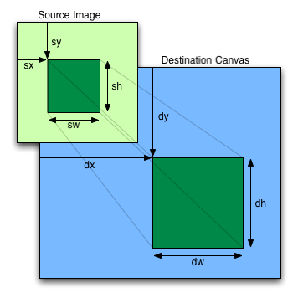
More Layout
We then take the point in the center of the grid and make it a square (later we will import the image of a flappy bird into the square). The square represents the area that the bird is occupying.
The area of the bird is key to determining if the bird has scored or crashed.
Through trail and error we determined that a circle is a much easier shape to work with. It works much better for our overlap function (which will be discussed later)

Slide 10
The Wall
We’ve got our square flappy bird. Now lets build some obstacles for the bird to eventually avoid.
But before we build the obstacle lets define what the obstacle will eventually do.
In tandem with its partner the obstacle will move from the right side of the screen towards left side. We will not yet program any movement function, but it is important to know what the obstacle will be doing so we can build the obstacle in the right starting location.
So remember how we built the bird. Pick a point but not any point one that is on the right hand side of the screen, and instead of a square we want a wall as an obstacle so we use a greater height than width to achieve the rectangular shape of the wall.

Slide 11
Just Another Brick In The Wall
So Every wall has two parts a top wall and a bottom wall.
The bottom and the top wall should never over lap in fact there needs to be an if statement that keeps enough distance between the top wall and the bottom wall so that the bird can flap through.
Next we create a function that moves the Wall. Then we apply that function to both Top and bottom sections.
Some adjustment is necessary to get the speed to a level that works good for the beginning of the game.
So the wall has moved from the right hand side of the screen all the way to the left.

Slide 12
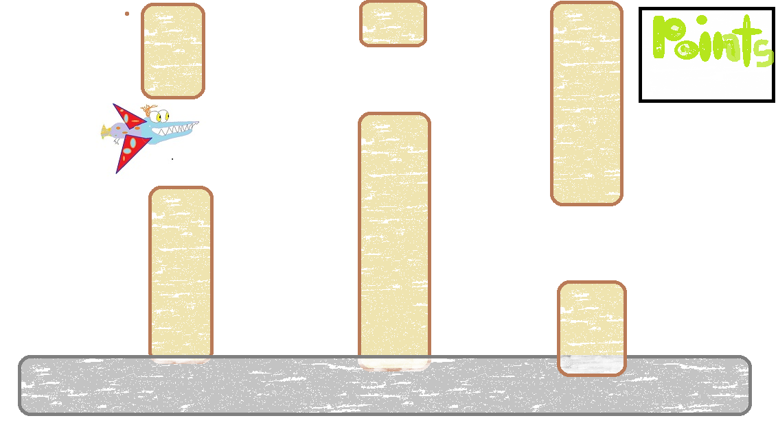
One Wall is Just Not Enough
We could just make another identical top and bottom wall, but that’s boring and not challenging enough for the player.
We create an array to store multiple walls systems so the game is challenging.
The array creates random sized walls.
We will later try and use an if statement to control the maximum height (so the game is not impossible) and minimum height (so the game is not to easy).

Slide 13
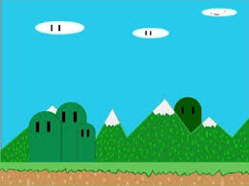
Ready to take flight
In addition to making the walls move. We also have to make it so the Bird can flap over the obstacle.
We create the Fall function that resembles gravity on our two dimensional canvas.
The Jump function stops the fall function from occurring. We use an on click function to lift the bird every time the mouse is clicked the bird lifts a certain amount.

Slide 14
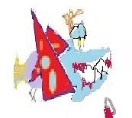
Overlap Function
The Overlap Function is accomplished with an if statement.
If the wall defined by x, y , width, and height. Equals to any coordinate that the bird (x, y, width, and height.) is occupying than the bird is dead.
When the bird dies it can no longer flap and the game resets and score counter resets.

Slide 15
What Next
Import svg files (with preexisting wall and bird images) or paint bird and walls from scratch.
We have successfully imported some svg files, but it messes up our overlap function.
We may add different bird types to pick from. Different images and different physics.
Import different files that represent different states of the bird.
For instance flap wings down image will appear when bird starts to lift.
Flap wing up image will appear when flap function ends and fall function takes back over.

Slide 16
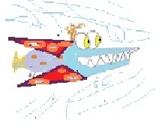
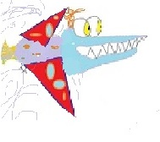
Bird States
Initial flappy bird.
Fall bird state.
Flap up bird state.
Dead bird state.

Slide 17
Sound Effects
We have added some flappy sounds.
We will add a crash sound as well and maybe some other sound effects.
We may add some background music.
Maybe a different song if your score makes the Leader board.

